Slide 1

THE DAY YOU BEGIN
ABC BUILDING YEAR LESSON 3
Fairmeadow Elementary School
Mari Ueda-Tao and Parvathi Belur
(Room 5 – Hart/Van Bruggen)
1. THE DAY YOU BEGIN| @2019 YMCA Project Cornerstone
Notes:
This presentation is intended for use as a training resource for ABC Leads at the monthly ABC Lead training hosted by Project Cornerstone. Many of these slides provide additional materials and resources for ABC Leads and ABC Readers to compliment and update the Lesson Plan.
ABC Leads are encouraged to use this resource to support their own school site ABC Reader training. Notes for facilitating a discussion with this presentation accompany each slide.
Suggested Resources:
ABC Lesson Plan
ABC Outline
1.

Slide 2
ABC: Building Year, Book 3
Summary
3. THE DAY YOU BEGIN| @2019 YMCA Project Cornerstone
Notes:
Note to ABC Leads:
Provide a summary of the book, or demonstrate “How to Read This Book” as part of your ABC School Site Training.
Book Summary:
This is a heartening book about finding courage to connect, even when you feel scared and alone. There will be times when you walk into a room and no one there is quite like you.
There are many reasons to feel different. Maybe it’s how you look or talk, or where you’re from; maybe it’s what you eat, or something just as random. It’s not easy to take those first steps into a place where nobody really knows you yet, but somehow you do it.
The narration of the book can be found here: https://www.youtube.com/playlist?list=PLBsUra9Uf_EwnImkDeBqykrgjYhPJGtjs
3.

Slide 3
Information: Lesson Goals
Students will:
  express tolerance and acceptance of others
recognize and value all dimensions of diversity
perform inclusive behaviors and/or acts of kindness to create a caring school climate.
5. THE DAY YOU BEGIN| @2019 YMCA Project Cornerstone
Notes:
Refer to Lesson Plan, page 1
Refer to Outline, page 1
Ask volunteers to read the goals:
Students will learn how to embrace and nurture each individual for who they are.
Students will recognize and value all dimensions of diversity.
Students will practice inclusive behaviors to create a caring school climate where every voice is heard.
5.

Slide 4
Conversation
Starter
6. THE DAY YOU BEGIN| @2019 YMCA Project Cornerstone
Notes:
Refer to Lesson Plan, page 2
How to deal with bias during discussions (What we permit, we promote!)
When students share put downs, bucket dipping experiences or cold pricklies, it is likely they will share derogatory labels and stereotypes about race, religion, sexual orientation, and gender. Some children may be passing on comments they have heard, but not understood. Others may reflect the bias deeply embedded in our society. Regardless of the roots of the comments, remember no child is born prejudiced - the ideas are learned. When you hear a comment expressed, don’t be afraid to take a second and say something. A response to what you heard is better than ignoring the situation. Here are some ways and ideas to respond:
Respond thoughtfully and simply say:
Everyone at our school deserves to feel safe and cared for.
Everyone deserves our kindness and respect.
Remember we fill buckets in this class.
It’s not OK to use that phrase.
Be gentle and instructive. Say:
What do you mean by that?
Do you know what that means?
You may not have meant to be hurtful, but when you use the word “____” to mean something is bad or stupid, it is hurtful. Do you know why?
Correct and inform students in a non-judgmental way.
If you have time to educate on the spot, do it.
If not, mention the incident to the teacher.
Encourage empathy by asking children to imagine how they would feel if that particular comment was said about them.
6.

Slide 5
Conversation Starter:
Feeling Different
7. THE DAY YOU BEGIN| @2019 YMCA Project Cornerstone
Notes:
Refer to Lesson Plan, Conversation Starter, page 3
Refer to Outline, page 1
Option One Grades K-3
Bring in a puppet. Introduce your friend. What is something about you that’s different from everyone else? How are people alike on the inside? Pair students off and have them stand up. Ask them to look at other and ask the following questions and share out loud:
“How are you and your classmate alike?”.
“How are you and your classmate different?”
“What is something you’re good at?”
“How can you help someone?”
Option One Grades 4-6
Ask, “Have you ever walked into a room full of people who seemed different than you?” Think about this for a minute. “How did you feel? What made you feel that way? Discuss your feelings and how they changed as time passed. Now ask, “What do you think students would say about you when they met you for the first time?”
Use this video to show that seeing the differences to other is a learnt behavior. https://www.huffpost.com/entry/heartwarming-video-shows-how-kids-see-differences_n_594a8182e4b0db570d381868
7.

Slide 6
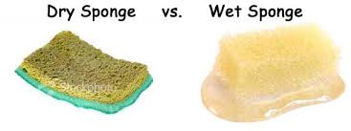
Conversation Starter:
Feeling Unique | Grades 2-6
Have you ever felt closed up and small?
        Have you ever felt that you grew and opened?
8. THE DAY YOU BEGIN| @2019 YMCA Project Cornerstone
Notes:
Refer to Lesson Plan, Conversation Starter, page 3
Ask the 2 questions to students about the different states the 2 sponges. Ask students to brainstorm why they think the 2 sponges are different. All answers are welcome.
Now say what if water in this case was like our attitude? Attitude just like water matters. It makes a whole difference in the way we live our life.
The way we look, we dress, we think, we act, and simply the way we are makes us unique. There’s no one single person alike. We are all unique like snowflakes or grains of sand.
Each of us have value to add, and we shouldn’t refrain ourselves from actively engaging in the life of our classroom, our school, and our neighborhood. The world needs YOU!
8.

Slide 7
Reading
The Book
9. THE DAY YOU BEGIN| @2019 YMCA Project Cornerstone
Notes:
Refer to Lesson Plan, Read the Book, page 4
Refer to Outline, page 2
Special Note to ABC Leads:
The Day You Begin addresses feeling different. Although it is not explicitly mentioned in the book, we can help students have a conversation on how to accept and tolerate those that look, sound or behave different than us. The challenge we want to give our students is to proactively depict inclusive behaviors that promote a caring school climate that integrates everyone in the community.
Option One: Do a picture walk without reading the words. (It’s a way to raise interest and to check where the class is standing regarding being accepting and tolerant).
Option Two: Let children guess what the content is judging by its title.
Allow time for the discussion and make sure to adapt the types of questions according to the age and maturity of the class.
9.

Slide 8
Discussing
The Book
10. THE DAY YOU BEGIN| @2019 YMCA Project Cornerstone
Notes:
Refer to Lesson Plan, Discussion Section, pages 4-5
Refer to Outline, pages 2-3
In the Lesson Plan there are 17 questions to conduct the discussion of The Day You Begin. They are classified according to the grades the questions are intended for.
Your choice of question will depend on the grade you’re working with. Read them thoroughly and be prepared to facilitate the discussion with the students. Guide them and validate their feelings when listening to them.
10.

Slide 9
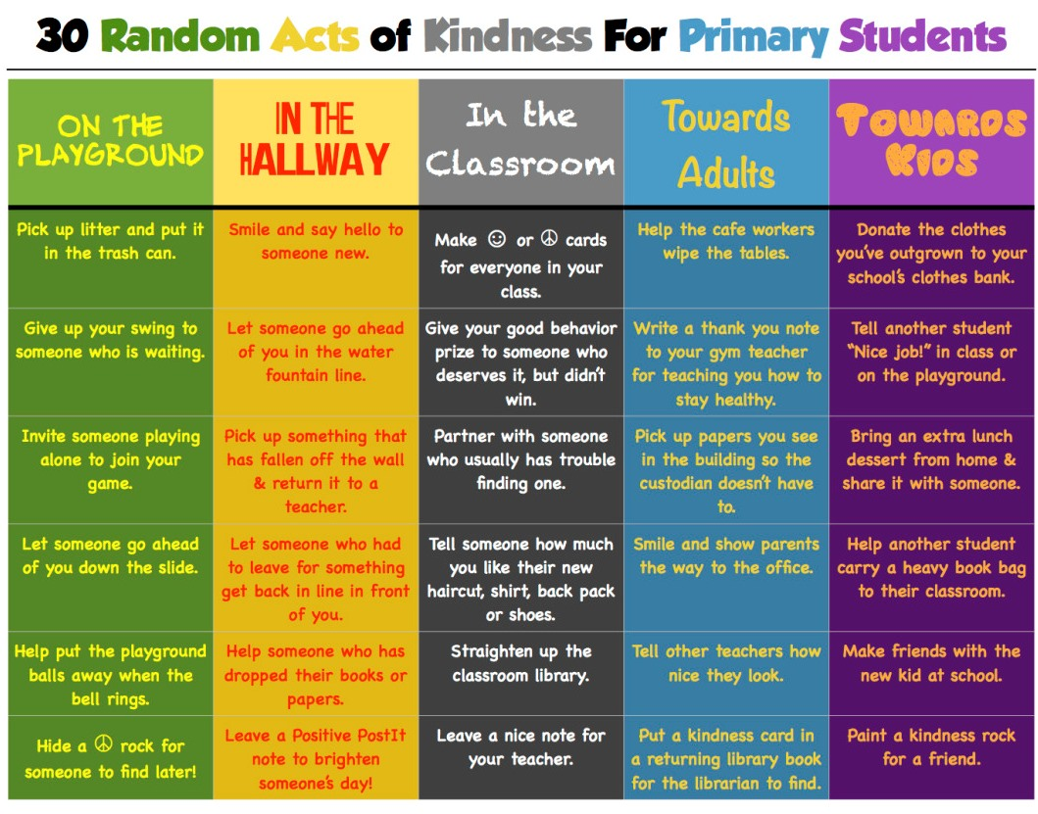
Discussion: A Caring School Climate
25. THE DAY YOU BEGIN| @2019 YMCA Project Cornerstone
Notes:
Intentional Acts of Caring will definitely promote a caring school climate. You can always start here. Being inclusive implies being kind to those we interact with.
The chart provides many ideas for students to be constantly kind wherever they find themselves.
How can you impact the atmosphere of your school? What kind of agreements can we work toward to make sure we exhibit caring towards one another?
Leave your Acts of Caring chart behind for the teacher to use as a resource.
Order posters and learn more at:
http://primarilypeace.tumblr.com/post/103424353093/i-made-this-in-response-to-todays-twiter-activity
25.

Slide 10
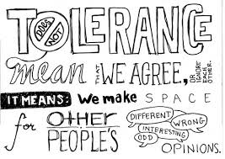
Discussion: Tolerance & Acceptance
Upper Grades
11. THE DAY YOU BEGIN| @2019 YMCA Project Cornerstone
Notes:
Refer to Lesson Plan, Discussion Section, page 4
Ask students: “Are acceptance and tolerance the same or different?”
Discuss the answer with students.
Tolerance is being patient, understanding, and accepting of anything different. An example of tolerance is Muslims, Christians, and Atheists being friends.
However, acceptance goes a step beyond tolerance. A sign of tolerance is a feeling of “I can live with certain behavior, religion, race, culture, etc.” . Acceptance moves beyond that. You can tolerate something without accepting it, but you cannot accept something without tolerating it.
Let’s walk our talk. Let’s invite students to tolerate and accept those who are different from them. At the end, we’re all human and deserve to be valued, respected, and known.
11.

Slide 11
Discussion: Diversity & Inclusion
We see differences. We accept differences.
We know that in spite of differences, we all want to be treated in ways that make us feel safe and cared for.
12. THE DAY YOU BEGIN| @2019 YMCA Project Cornerstone
Notes:
Refer to Lesson Plan, Discussion Section, page 4
Show this “Anti-Exclusion Video”:
https://www.youtube.com/watch?v=PXtxFzuGaxY
Discuss with Students:
Share a time when you wanted to fit in and you didn’t know how.
What can you do next time you find yourself in the same situation.?
What tools will you need?
Pair share with your neighbor.
Go to next slide to continue the conversation.
12.

Slide 12
Discussion: Inclusive Behaviors
The Day You Begin to…
  Greet each other authentically
  Resolve misunderstandings and disagreements immediately
  Listen
  Speak clearly, directly, and honestly
  Use your voice
  Understand everyone has value to add
  Invite others to share
  Be brave
13. THE DAY YOU BEGIN| @2019 YMCA Project Cornerstone
Notes:
Refer to Lesson Plan, Discussion Section, page 4
Let’s debrief what you pair shared. Look at the slide. This is how we can be an example of being inclusive on our campus. Let’s talk in a respectful and inclusive manner. To do so, we need to grow our awareness of our common ground.
Brainstorm with students. Write their answers to these questions on chart paper:
What do we have in common in this classroom?
Ask them: “Why is being brave important?”
All UPstanders are brave. They know it takes courage to defend others. They don’t necessarily agree with them.
This can be an end to the discussion or a 3 minute huddle. Challenge your class to select and do 3 of the behaviors in the slide as a class for a month until the next ABC reading.
13.

Slide 13
Activity Ideas
14. THE DAY YOU BEGIN| @2019 YMCA Project Cornerstone
Notes:
Choose an activity to match your goals for the lesson. The activity should not be a distraction, but rather deepen understanding.
As the ABC Lead, will you provide activity ideas for each grade level? Will your volunteers select activities, individually?
Gather volunteer feedback on how your community will use the lesson activity to build relationships and a more caring school climate (Asset #5).
14.

Slide 14
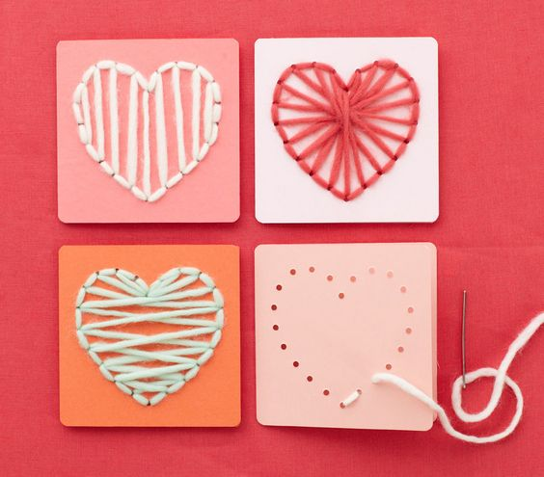

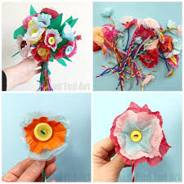
Hands-on Activities K-6
Weave your own story
Everyone in our
class is special
“We’re unique and beautiful” Bouquet
15. THE DAY YOU BEGIN| @2019 YMCA Project Cornerstone
Notes:
Refer to Lesson Plan, Group activities, pages 5-6
Refer to Outline, page 3
Here are 3 different options of hands-on activities for this book.
Choose the one suits your style the best. Also, take into consideration the age and skill of the children, the time you have to prepare and to do the activity, and the overall impact in the campus.
Everyone in Our Class is Special is for K-6.
Students write about unique traits on a shape and create a class poster.
Weave Your Own Story is for K-6.
Students express who they are by weaving ribbon or yarn on a heart.
“We’re Unique and Beautiful Bouquet is for K-6.
Create a class bouquet with individual flowers that celebrates diversity in a classroom.
15.

Slide 15
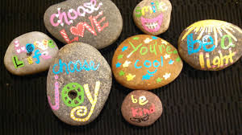
Grow a Kindness or Inclusion Garden
All Grades
16. THE DAY YOU BEGIN| @2019 YMCA Project Cornerstone
Notes:
Refer to Lesson Plan, pages 6-7, How to Grow a Kindness/Inclusive Garden handout for each student, large mural paper
Ask the students to list ideas on what being kind looks like. Discuss with them that it is easy to be kind to people we have things in common with. It is much harder to be kind toward people who we think are “different”. To be inclusive we must be open to learning about each other and discovering what we have in common and learn more about each other’s differences.
Have each student think of an intentional act of caring or being inclusive that they have done for someone else or plan to do (give a hug, smile, take out the trash, set the table, be an UPstander when someone was teased, share a special food, include someone in their game etc.).
Have them draw a picture or write a few sentences in the center of the flower to remind them of their intentional act of caring. On the petals, ask them to write two words of how that felt for them and how they think their intentional act of caring felt for the other person. They can cut out the flower and paste it on the mural titled “Kindness Garden” or “Our Inclusive Garden”.
This is a wonderful activity to be done throughout a month. It reminds and reinforces the intent of being kind in order to create a kind environment in the school for everyone.
16.

Slide 16
Closing:
3-Minute Huddle
23. THE DAY YOU BEGIN| @2019 YMCA Project Cornerstone
Notes:
Refer to Lesson Plan, page 11
Refer to Outline, page 4
Remind students of the ideas they had to create a caring classroom/school listed during the group discussion. Have them think about 1 kind thing they can commit to doing that day for another student. Stress that it must be something they can do today. Model the activity by beginning with a commitment to something yourself. If there is time, have them share their action item out loud to the whole group. If time is short, have them pair-share with a partner.
Or
Have students each say or write how you like others to show that they care about you?
Write their ideas down if done orally. Cut up and put in a bucket. Give to the teacher to read 1 idea each day.
23.

Slide 17
Next Meeting | Change of Date & Location
Next Book Training for “Today I Feel Silly” rescheduled to Wednesday, December 4 at 8:35am in Room 17

